Slide 1
NETFLIX DATA ANALYSIS

Slide 2

TEAM MEMBERS
Manthan
Krishna
Ganesh
Mani
Rishi chan
Vamshi
Mahendren
Nithya

Slide 3
Project Overview:
This project aims to analyze the content available on netflix streaming platform. The study will analyze the different content available across different countries and its content creators.

Slide 4
Objective:
The Objective of the project is to identify the content types available on netflix, across different countries, types of content available with similarity, top actors appearing in most contents, top directors creating most content and what netflix is focusing on in recent years w.r.t Movies or Tv shows.

Slide 5
Methodology:
Involves the following steps:
Business Understanding
Data Understanding
Data Preparation
Data Exploration

Slide 6
Python
Tableau
Business Understanding
Data Visualization
Data Understanding & Data Preparation
Dashboard creation
Data Exlopration

Slide 7
Business Understanding
Understanding what content is available in different countries
Identifying similar content by matching text-based features
Network analysis of Actors / Directors and find interesting insights
Does Netflix has more focus on TV Shows than movies in recent years.

Slide 8
2. Data Understanding
Explored the data using pandas DataFrame
Identified the patterns and relationship between
columns type, director, cast, country e.t.c

Slide 9
2. Data Preparation
Performed data cleaning by removing missing values.
Transformed the data by separating multiple values in the columns by splitting the data column wise.
Used text pre-processing technique on column containing data in details or in sentences to transform the data to find similar words or most common words for example column “description” in this data.

Slide 10
2. Data Exploration
Explored the data from previous Data preparation stage using identified patterns and relationships
Python libraries used Matplotlib, WordCloud.
Tableau used for visualization from data prepared using python.

Slide 11
ANALYSIS

Slide 12
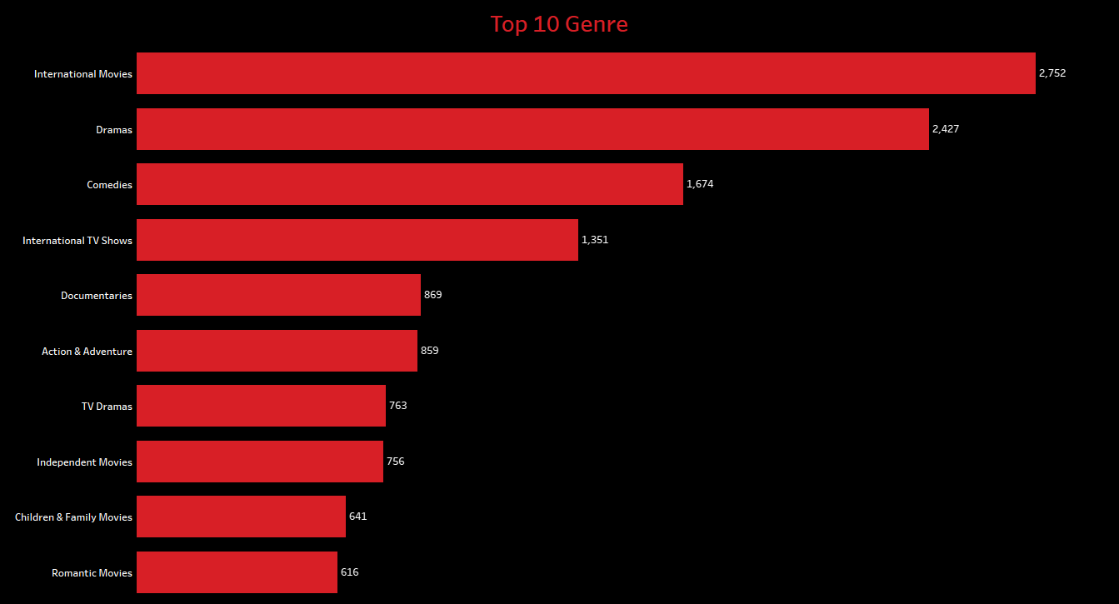
Contents listed in Genre
Understanding what content is available in different countries.
Countries with most contents.
Most of the contents are listed in International Movies, as movies have the most number of contents and Netflix platform is accessible all over the world, so most of the contents will be listed in this genre.
Contents listed in Dramas grabs the top spot in genres.

Slide 13
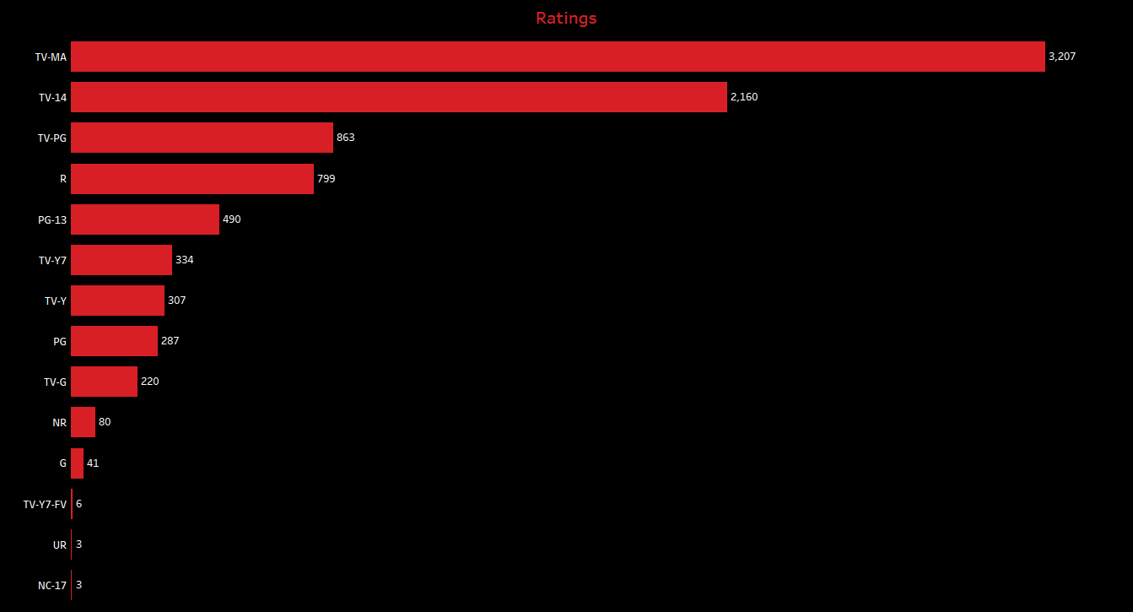
Contents with ratings
Highest number of contents available on netflix are intended for mature, adult audiences and maybe unsuitable for childrens under 17
Followed by the contents which are available for under 14, and maybe unsuitable for for childrens under 17.
Least number of contents are under UR and NC-17, which states the content admitted for No one under 17.
So, most of the contents are intended for mature and adult audiences above age 17.

Slide 14
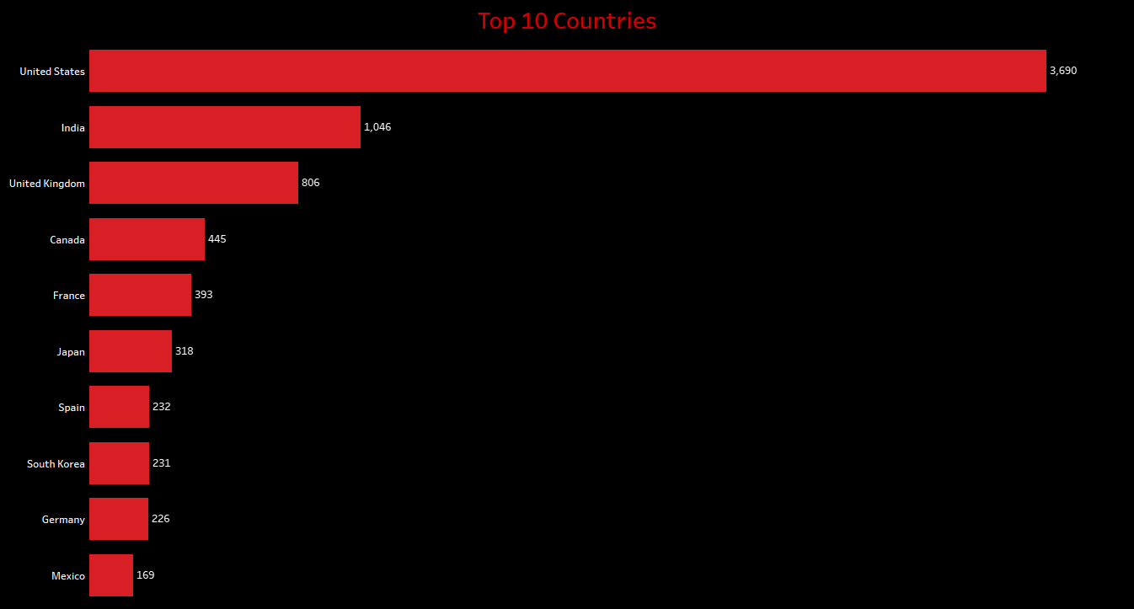
TASK 1
Understanding what content is available in different countries.
Countries with most contents.
USA is the first country which have more than 3600 contents on Netflix
Secondly India which have more than 1040 contents on Netflix followed by UK.

Slide 15
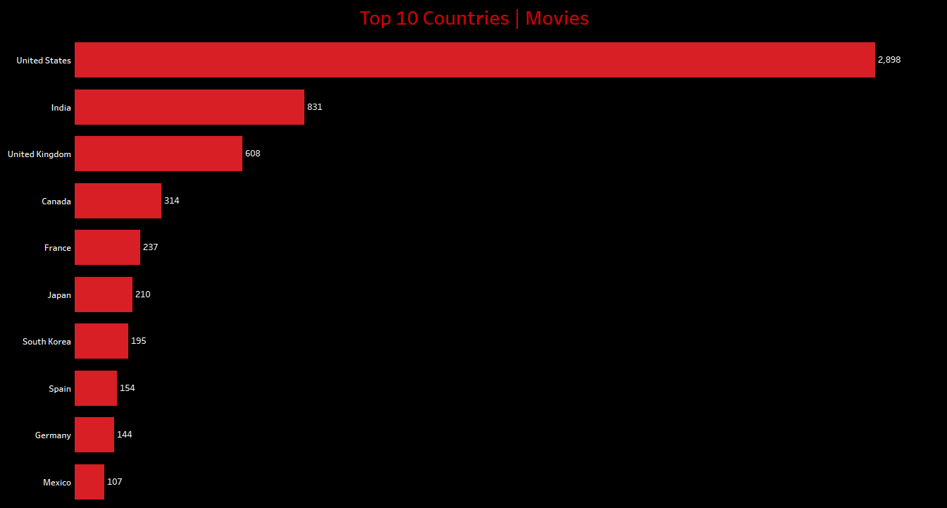
TASK 1
Understanding what content is available in different countries.
b. Movies w.r.t countries.
USA is the first country which have more than 2890 movies on Netflix
Secondly India which have more than 831 movies on Netflix followed by UK.

Slide 16
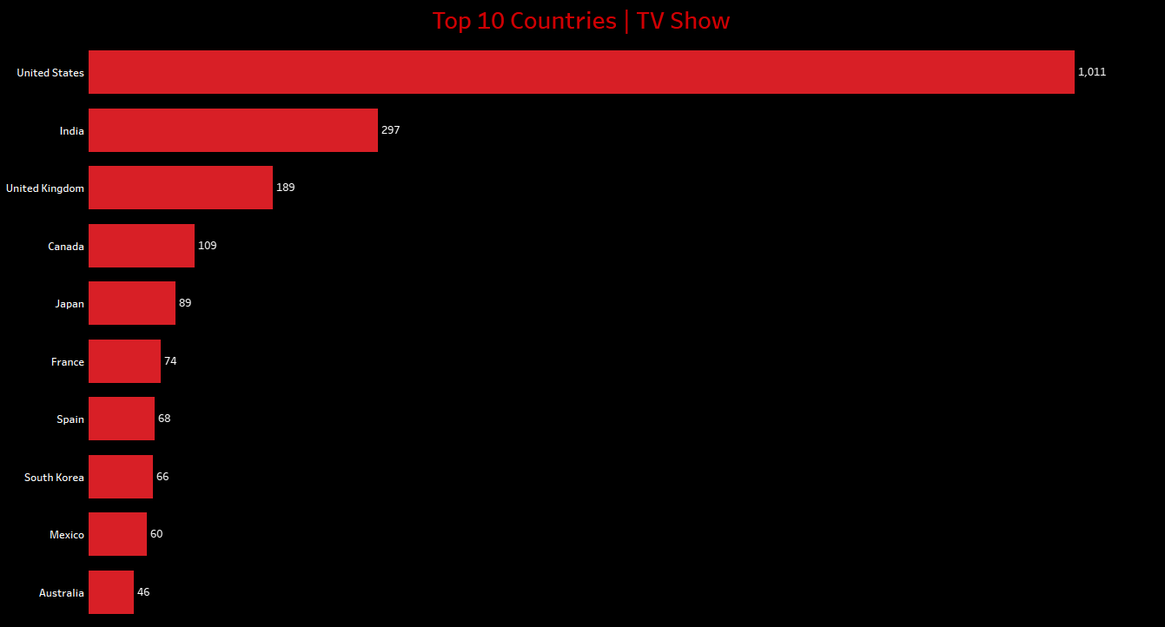
TASK 1
Understanding what content is available in different countries.
b. TV shows w.r.t countries.
USA is the first country which have more than 1000 TV shows on Netflix.
Secondly India which have nearly 300 TV shows on Netflix followed by UK.

Slide 17

TASK 1
Comparing analysis for Top 10 Countries in Movies and TV shows, Countries United States, India, United Kingdom, and Canada grabs the top 4 spots respectively.
While there are changes in order after top 4 countries.

Slide 18
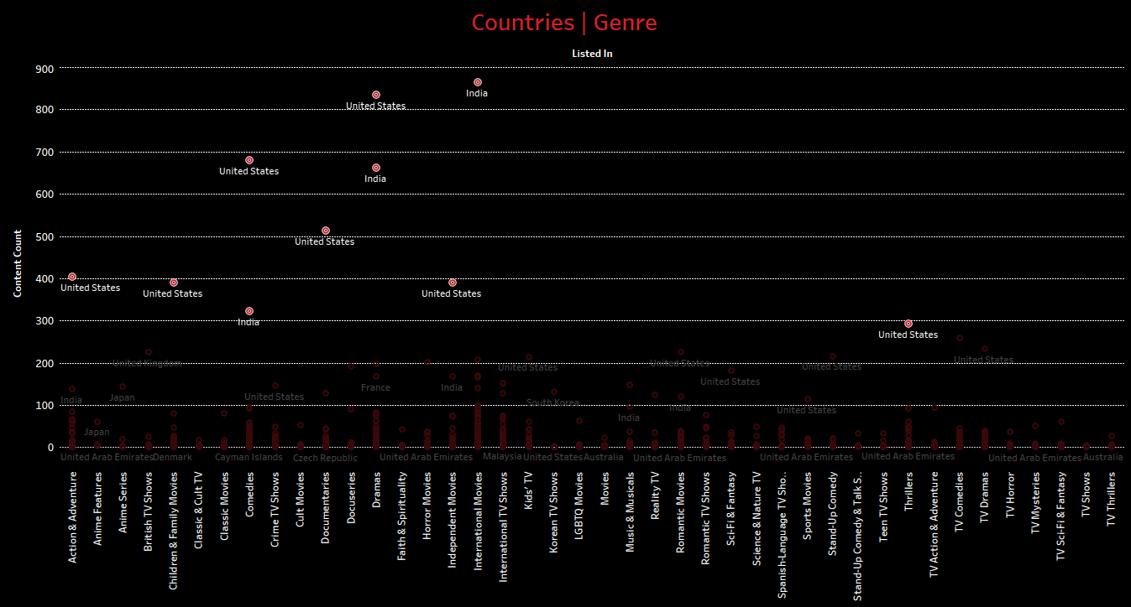
D. CONTENT LISTED IN GENRE W.R.T COUNTRIES
Totally 43 different types of genres available on Netflix
As United States and India are among top countries in contents on netflix, out of top 10 contents with countries and genre, India has holds top in International Movies followed by Dramas and comedies.
While United states have most of the contents in genres, dramas, comedies, documentaries,, action & adventure, children & family movies, independent movies and thrillers respectively.

Slide 19
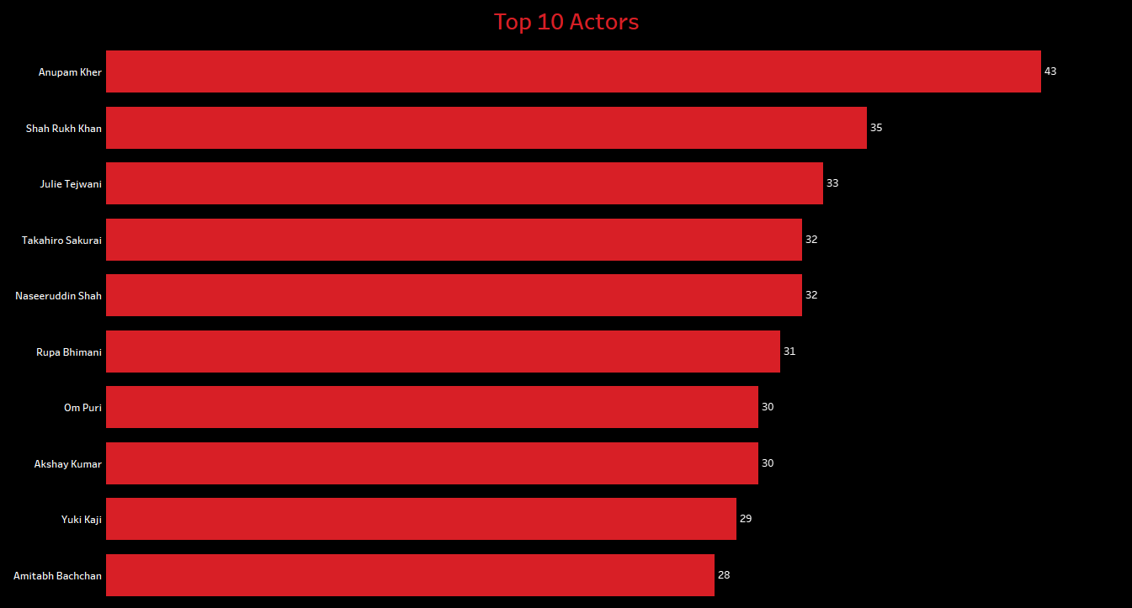
TASK-3 NETWORK ANALYSIS OF ACTORS / DIRECTORS AND FIND INTERESTING INSIGHTS
a. Top Actors appeared on netflix
Anupam Kher
Shah Rukh khan
b. If we look closely most of them are from Indian origin.

Slide 20
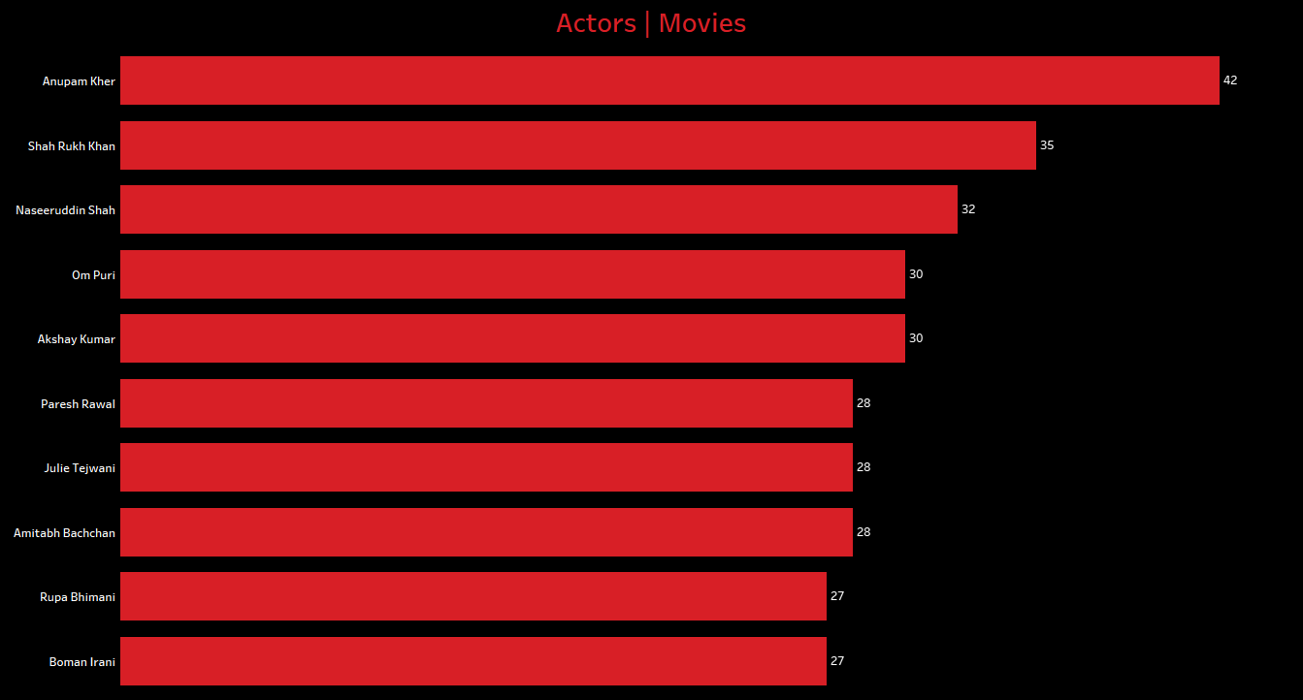
TASK-3 NETWORK ANALYSIS OF ACTORS / DIRECTORS AND FIND INTERESTING INSIGHTS
b. Top Actors appeared in movies
Anupam Kher
Shah Rukh khan

Slide 21
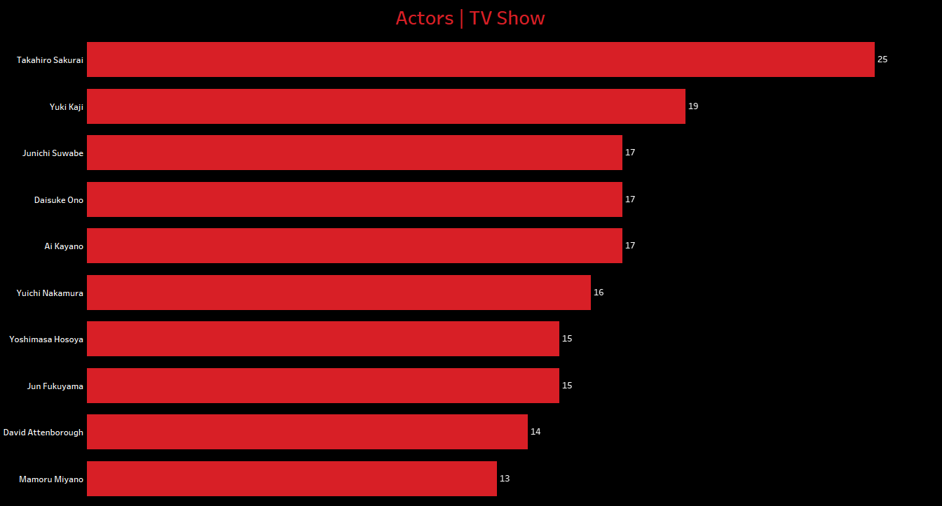
TASK-3 NETWORK ANALYSIS OF ACTORS / DIRECTORS AND FIND INTERESTING INSIGHTS
c. Top Actors appeared in TV shows
Takahiro Sakurai
Yuki Kaji

Slide 22
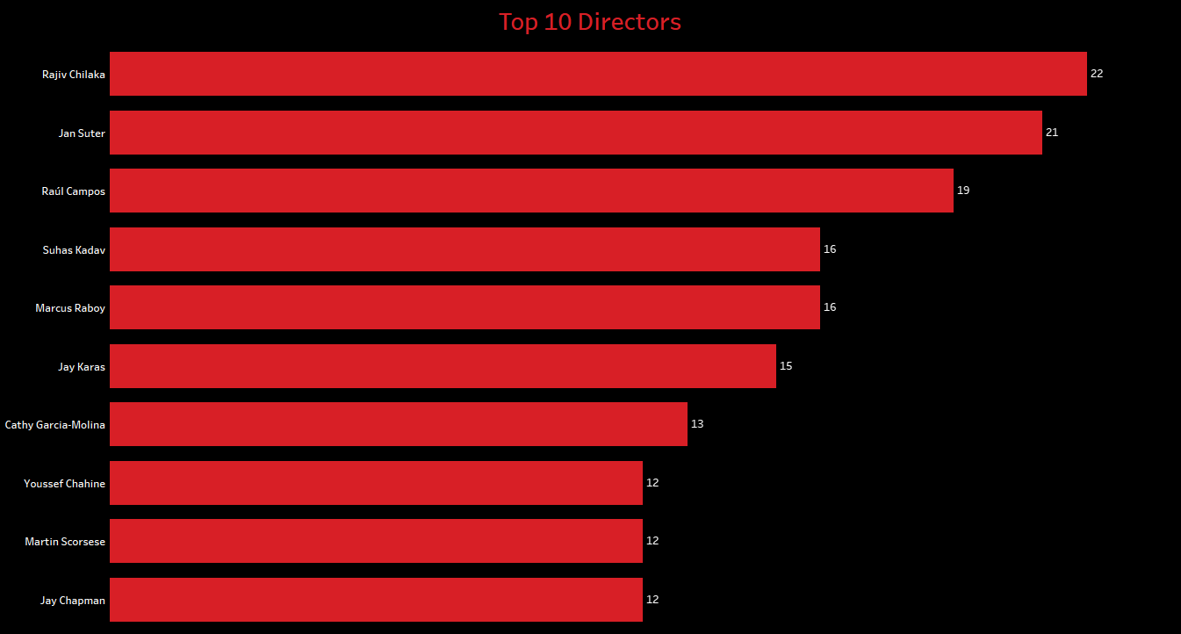
TASK-3 NETWORK ANALYSIS OF ACTORS / DIRECTORS AND FIND INTERESTING INSIGHTS
d. Top Directors on netflix
Rajiv Chilaka
Jan suter

Slide 23
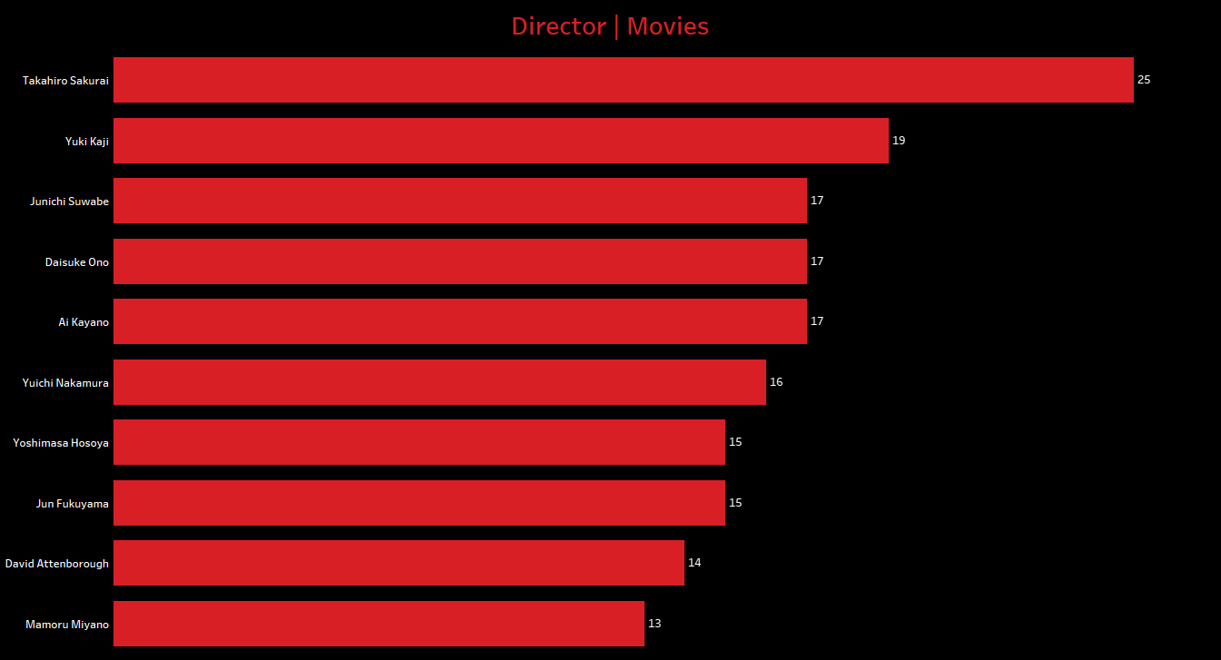
TASK-3 NETWORK ANALYSIS OF ACTORS / DIRECTORS AND FIND INTERESTING INSIGHTS
e. Top Directors for movies
Takahiro Sakurai
Yuki Kaji

Slide 24
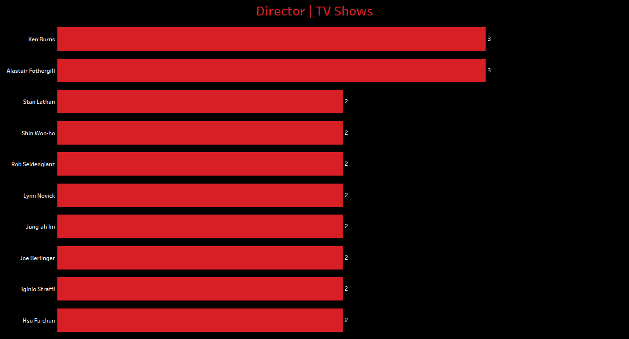
TASK-3 NETWORK ANALYSIS OF ACTORS / DIRECTORS AND FIND INTERESTING INSIGHTS
f. Top Directors for TV shows
Ken burns
Alastair Fothergll.

Slide 25
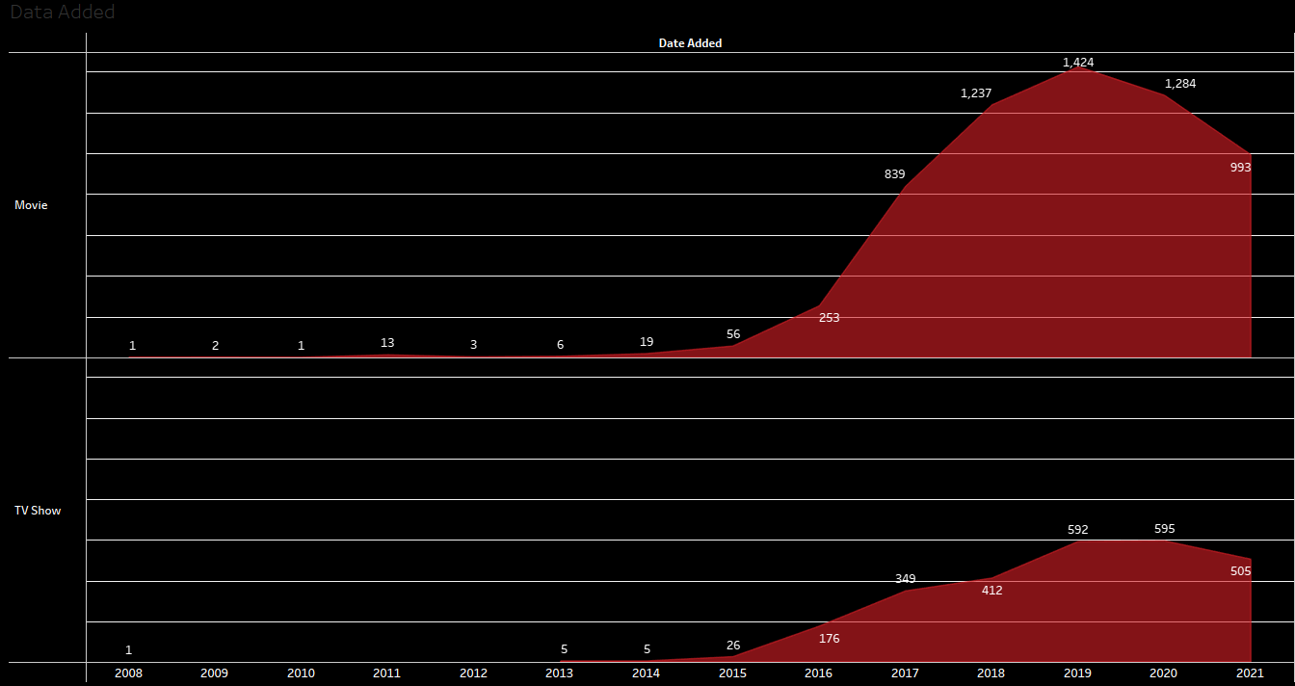
TASK - 4 DOES NETFLIX HAVE MORE FOCUS ON TV SHOWS THAN MOVIES IN RECENT YEARS?
Type of content and its Date Added with number of contents.
As per the Viz Netflix got more contents after 2015 only.
In 2019,2020,2021 during the covid times all the theatres were shut, so Netflix got more popular from that particular years.
Most of the movies directly released on the OTT platforms.
While there is decline in adding contents on netflix for movies after 2019 , TV shows are stable.

Slide 26
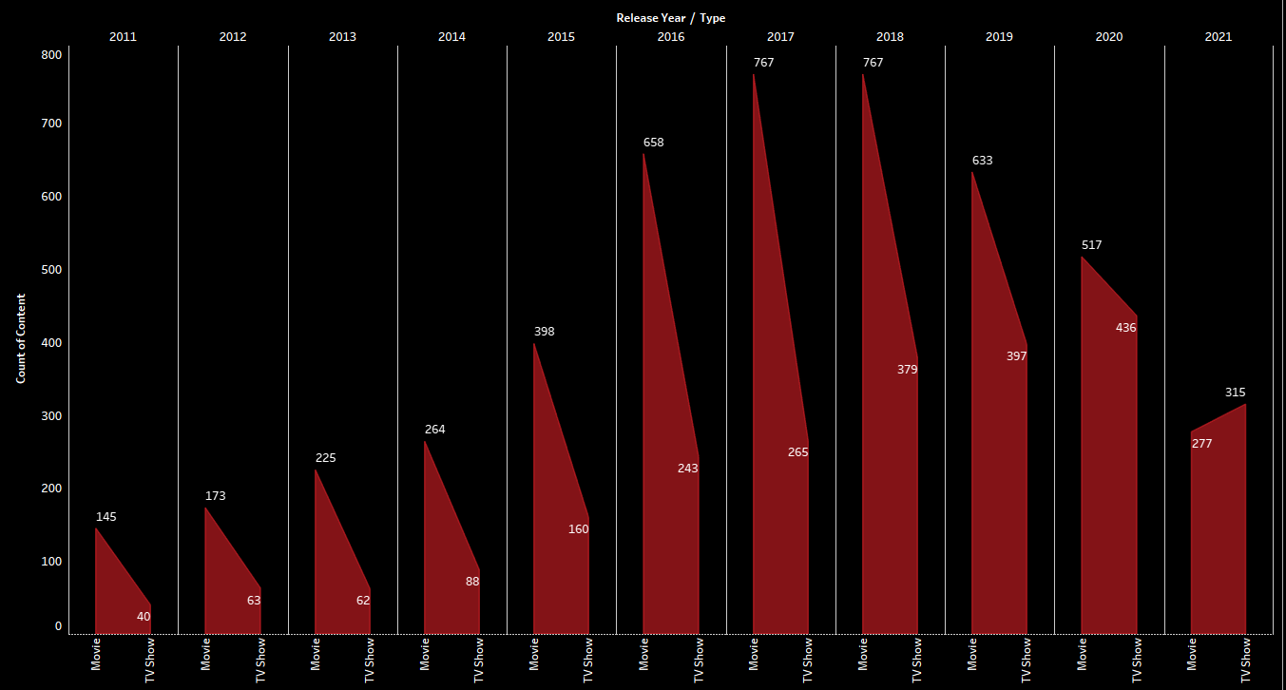
TASK - 4 DOES NETFLIX HAVE MORE FOCUS ON TV SHOWS THAN MOVIES IN RECENT YEARS ?
According to this dataset,
In the past decades from 2011-2020 Netflix focus more on Movies.
Whale after 2021 Netflix focused more on TV shows than Movies.

Slide 27
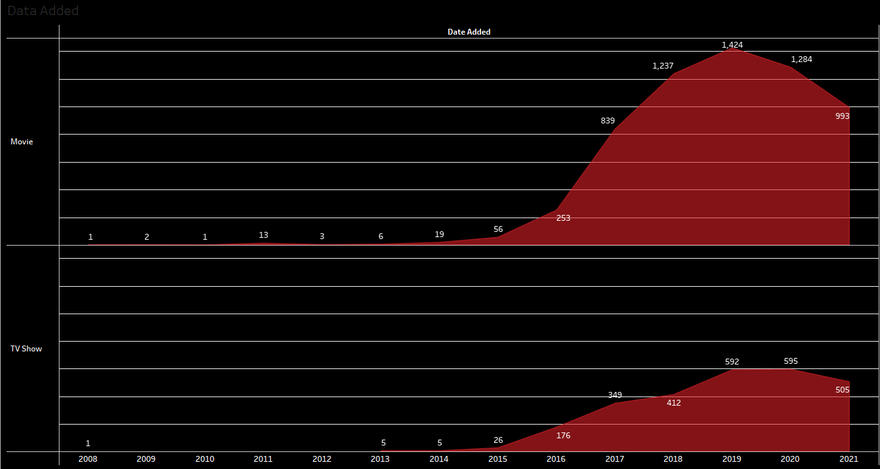
TASK - 4 DOES NETFLIX HAVE MORE FOCUS ON TV SHOWS THAN MOVIES IN RECENT YEARS ?
Comparing contents added in recent years and release year, Netflix have more FOCUS on TV SHOW than MOVIES.

Slide 28
THANK YOU

